Slide 1

INTEL UNNATI INDUSTRIAL PROJECT
Presented By : Team Bugs
Gitam University | 2024

Slide 2
PROBLEM STATEMENT
1
Title: "Innovative Monitoring System for Tele lCU Patients Using Video Processing and
Deep Learning"
Objective:
The primary objective of this project is to develop an deep learning AI-based solution that can analyze patients movement using data from cameras capturing patients living footage. The solution should provide insights on patients movement patterns, Doctor Identification and Nurse identification.
Problem Description:
Tele lCI is concept for monitoring ICU patients from remote locations to reduce the burden of
on-site intensivist. Currently there are multiple products available in this domain where one
profession seating at remote location physically monitors one or two remote patients in
Tele lCU. The proposed solution should work to reduce the burden of remote health care
professional so. one remote health care professional can monitor 5 or more patients at single
time.

Slide 3
UNIQUE IDEA BRIEF (SOLUTION)
2
The Innovative Monitoring System leverages video processing and deep learning technologies to continuously monitor ICU patients. This system detects critical events and alerts medical staff in real-time, improving patient outcomes and reducing the burden on healthcare providers.
Real-time Video Monitoring: Continuous video surveillance of ICU patients . Automated detection of patient movements, falls, and other critical events using deep learning algorithms. Immediate alerts to medical staff via mobile devices, computers, or integrated hospital systems .Ensures compliance with healthcare regulations and protects patient data through encryption and secure data handling practices.
Gitam University | 2024

Slide 4

FEATURES OFFERED
3
Real-time Video Monitoring
Video Processing
Deep Learning Algorithms
Event Detection and Alert System
Gitam University | 2024

Slide 5
4
PROCESS FLOW
First Step
Second Step
Collection of video data from various YouTube videos. Cleaning of Unwanted frames
Label Generation for supervised learning. Separation of test & train.
Gitam University | 2024
Third Step
Final Step
data visualization report of patients and doctor movement through AI model and deep learning.
Analyzing the Storing for model generation & reusing and to create a data visualization report

Slide 6
5
TECHNOLOGIES USED
Programming Language:
Python
Technologies:
F-RCNN , Yolo Net, Microsoft Build Tools, Rob flow,Google colab.
Tools/Modules:
Open CV, NumPy, Tensor Flow, Tensor flow keras models, Tensor flow keras layers, OS, google.colab
Gitam University | 2024

Slide 7
6
TEAM MEMBERS AND CONTRIBUTION
Team Name - Team Bugs
Members and Contribution:
Shaik Nabi baba - Preprocessing, Analysis of Rubrics, Data Visualization, Outcomes
Siva Kumar - Data Set labeling, AI model training and testing, Data Integration
Gitam University | 2024

Slide 8
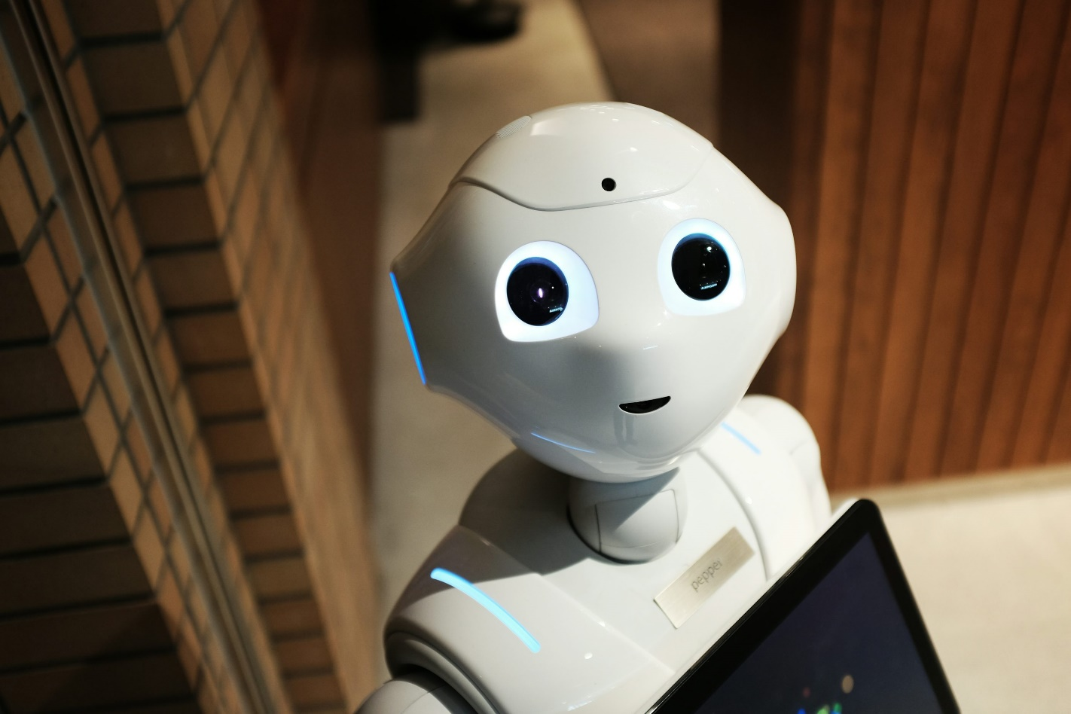
7
CONCLUSION
The Innovative Monitoring System for Tele ICU Patients Using Video Processing and Deep Learning represents a significant advancement in healthcare technology. By harnessing the power of video processing and artificial intelligence, this solution promises to improve patient outcomes, enhance operational efficiency, and support the evolving needs of modern healthcare facilities.
Gitam University | 2024

Slide 9
Gitam University | 2024
THANK YOU
Presented By : Team Bugs

